Slide 1
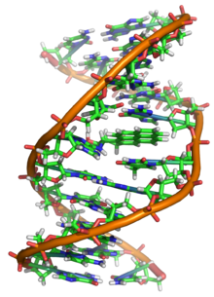
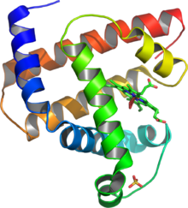
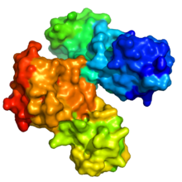
Small Molecules and Disease
PLOS Computational Biology: Translational Bioinformatics
David S. Wishart
Begetis Nikolaos
Konstantopoulos Dimitrios

Slide 2
1.Introduction
small molecules (amino acids, lipids, sugars)
Very important role in disease etiology and treatment
detect, identify, and characterize small molecules along with their large molecule targets
toxicology, pharmacology and biochemistry transformed into totally new fields called toxicogenomics, pharmacogenomics and metabolomics.
changed not only the fundamentals of these disciplines, but also the fundamentals of their data
Focus on “chemical bioinformatics”:
Important/useful chemical bioinformatic resources
Details on resources that allow researchers to connect small molecules to diseases
Newly emerging software tools

Slide 3
1. Introduction - continue
Chemical bioinformatics: thanks to the emergence of the above fields, there is a growing desire to bring bioinformatics and cheminformatics closer together.
“chemical bioinformatics”
a discipline that has evolved to help address the blended chemical and molecular biological needs of toxicogenomics, pharmacogenomics, metabolomics and systems biology.
combines the sequence-centric tools of bioinformatics with the chemo-centric tools of “cheminformatics
uses computers to facilitate the collection, storage, analysis and manipulation of large quantities of chemical data.
cheminformatic software is structure-based or picture-driven while bioinformatic software is sequence-based or text-driven.

Slide 4
1. Introduction - continue
At follow:
brief overview of some of the most important chemical bioinformatic resources
a more detailed overview on those particular resources that allow researchers to connect small molecules to diseases.
short discussion on newly emerging software tools that exploit these databases as a means to discover new biomarkers or even new treatments for disease.

Slide 5
Outline
Introduction
Sections:
Databases for Chemical Bioinformatics
SMPDB – A Pathway Database for Drugs and Disease
HMDB – A Resource for Biomarker Discovery and Disease Diagnosis
DrugBank – A Resource for Drug Discovery and Disease Treatment
T3DB – A Resource linking Small Molecules to Disease & Toxicity
Software for Interpreting Small Molecule & Disease Data
Summary
Misc – Links
Bibliography

Slide 6
2. Databases for Chemical Bioinformatics
Four major classes of chemical-bioinformatic databases:
small molecule (or metabolic) pathway databases;
metabolite or metabolomic databases;
drug databases;
toxin or toxic substance databases;
Yet still work to be done due to the nascent stage of this field and the difficulty in gathering and codifying disease-related information

Slide 7
2.1 Metabolic Pathway Databases
Perhaps the best known and most widely used
web-based resources:
the Small Molecule Pathway Databases (SMPDB) [5];
Kyoto Encyclopedia of Genes and Genomes (KEGG) [6];
the “Cyc” databases [7], [8], the Reactome database [9], WikiPathways, the Medical Biochemistry Page, etc.
Most expected to be useful for understanding the “big-picture” relationship between small molecules and disease – either with regard to those
small molecule compounds causing disease (i.e. toxins),
indicating disease (i.e. biomarkers) or
being used in the treatment of disease (i.e. drugs).
Most of these were designed to facilitate the exploration of metabolism and metabolites across many different species
enhancing our basic understanding of metabolism and our appreciation of biological diversity
Also, serve as the backbone to facilitate many practical applications in biology such as comparative genomics and targeted genome annotation

Slide 8
2.1 Metabolic Pathway Databases - Continue
Some DBs, such like KEGG and Reactome, tend to use pathway diagrams that are very generic and highly schematic,
While others are organism-specific (i.e. human-only), such as SMPDB and the Medical Biochemistry Page, tend to use diagrams that are very specific and much richer in detail, colour and content.
Most, support interactive image mapping with hyperlinked information content that allows users to view chemical information (if a compound is clicked) or brief summaries of genes and/or proteins (if a protein is clicked). And also some kind of text search.
A few, such as Reactome, SMPDB and the “Cyc” databases, support the mapping of gene, protein and/or metabolite expression data onto pathway diagrams
The major focus of most of today's small molecule pathway databases is on basic metabolism. and as a result, only one of these databases (SMPDB) actually includes any pathways associated with drug action or disease.

Slide 9
2.2 Metabolomic Databases
Focus most on chemicals and chemical descriptors with a lesser (or even absent) focus on biological data
Used for metabolite identification – especially in metabolomic studies
Resources:
Lipid Maps
ChEBI
PubChem
ChemSpider
KNApSAcK
METLIN
BMRB
MassBank
MMCD
HMDB
contains comprehensive data on most of the known or measurable endogenous metabolites in humans
Most expected to be useful for associating small molecule biomarkers with specific diseases, such as inborn errors of metabolism or a variety of chronic or infectious diseases characterized by metabolite imbalances

Slide 10
2.3 Pharmaceutical Product (Drug) Databases
Two types of electronic drug databases:
clinically oriented drug databases
e.g. DailyMed [10], RxList [11], etc.
very detailed clinical information (i.e. their formulation, metabolism and indications) about selected drugs derived from their FDA labels
Targeted to: pharmacists, physicians, consumers
chemically oriented drug databases
e.g. TTD [12], PharmGKB [13], SuperTarget [14], etc.
provide synoptic data (5–10 data fields per entry) about the nomenclature, structure and/or physical properties of small molecule drugs and, in the case of SuperTarget and TTD, their drug targets
support text, sequence and chemical structure searches
provide mechanistic, pharmacodynamic and pharmacokinetic pathway information
Appeal to: medicinal chemists, biochemists and molecular biologists
A hybrid of drug databases:
DrugBank
contains 80–100 different data fields, instead of 5–10 as seen with the other kinds of databases
supports very extensive text, sequence and chemical structure searches
provides detailed pathway information on the mechanism of action for >200 different drugs or drug classes.
Drug DBs obviously are the most relevant for identifying small molecules with disease treatments, although they could also be used to identify small molecule drugs causing adverse drug reactions

Slide 11
2.4 Toxic Substance Databases
Resources:
Animal Toxin Database (ATDB);
provides data on the sequence of many peptide/protein toxins from venomous insects and animals
information on the channel targets to which these toxins bind
Appeals to: animal physiologists
SuperToxic [15] and ACToR [16];
provide bioassy data and chemical structure information for a very large number of industrial or pharmaceutically interesting chemicals (>60,000)
Appeals to: environmental or industrial regulators (ACToR); medicinal chemists interested in toxicity prediction (SuperToxic)
Comparative Toxicogenomics Database [17]
provides literature-derived information on chemical-gene interactions. This includes microarray information on genes that are up/down-regulated upon contact or exposure to these chemicals
Appeals to: toxicogenomics or toxicology specialists
T3DB [18]
provides very extensive structural, physiological, mechanistic, medical and biochemical information on about 3100 commonly encountered (i.e. household or environmental) toxins and poisons.
Appeals to: toxicogenomics or toxicology specialists
Most expected to be useful for identifying the compounds causing diseases or causing symptoms associated with certain poisoning or environmental exposure incidents. This could include acute poisonings or more long-term, environmentally influenced conditions such as cancer, allergies or birth defects.

Slide 12
3. SMPDB – A Pathway Database for Drugs and Disease
An organism-specific pathway database that emphasises on clinical biocemistry and clinical pharmacology.
Expedites the observation and exploration of metabolism and metabolites of several species.
User-friendly, highly detailed and very specific pathway diagrams.
Outlines gene, protein and metabolite expression data onto the diagrams
Includes any pathway associated with drug action or disease

Slide 13
3.1 SMPDB –Database General Features
Includes more than 450 hand-drawn, human-specific pathways:
Metabolic pathways
Small molecule disease pathways
Small molecule drug pathways
Small signaling pathways
All pathways comprise:
Chemical structure of chemicals
Cellular locations of metabolites
Involving enzymes
Quaternary structures and cofactors
Organs that the processes may occur
Contains more than 100 unique metabolic disease pathways and more than 200 unique drug pathways

Slide 14
3.2 SMPDB –Browsing Features
Simplified database browsing
Protein/Metabolite lists of each pathway
Chemical structure querying
Sequence querying
Multiple entity highlighting and mapping

Slide 15
3.3 SMPDB –Database Interface
Interface modeled after the interface used for DrugBank and the HMDB.
Navigation Panel includes:
Browse
SMP-Browse
SMP-TOC
Search
SMP-Map
ChemQuery
TextQuery
Sequence Search
Download
Simple text browsing

Slide 16
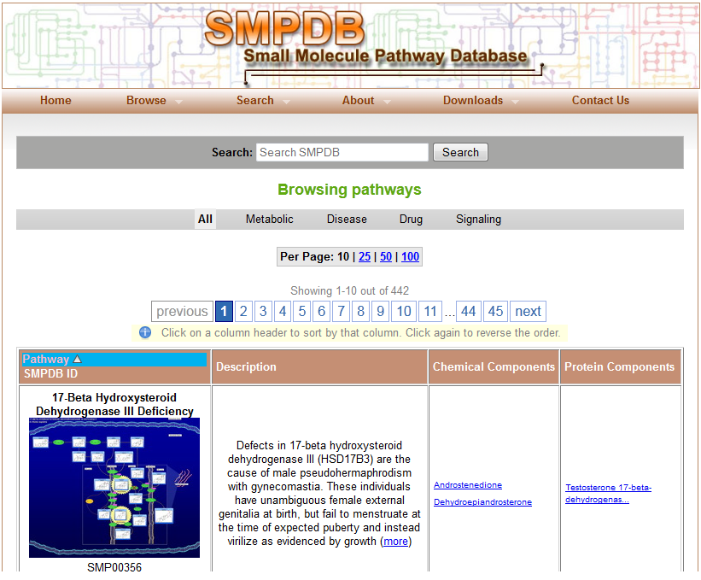

Slide 17
3.3.1 SMPDB –SMP-Browse and SMP-Toc Browse Options
SMP-Browse:
The default database pathways browser
A tabular synopsis of SMPDB's content
Pathway diagram images and pathway IDs
Pathway description
Corresponding chemical components and enzyme/protein components
Contents sorting ability
Links to HMDB, DrugBank, UniProt
Toc-Browse
All pathways listed by name and category
Pathway links
Pathway IDs

Slide 18
3.3.2 SMPDB –Image or Pathway Link Result
Zoomable image of the corresponding pathway
Pathway Legend link to:
General pathway components(metabolites, drugs, DNA,…)
Connectors (inhibition, activation, transcription)
Protein Components(enzymes, receptors, transporters..)
Cell and Organelle Components(organelles, membranes, cells)
Organ Components(heart, brain, liver, muscle..)
Pathway synopsis
References
List of metabolites/drugs and Proteins/enzymes found in the pathway (SMP-Highlight)
Illustration of increased or decreased concentrations of the above (SMP-Analyser)
Links to HMDB, DrugBank, UniProt

Slide 19
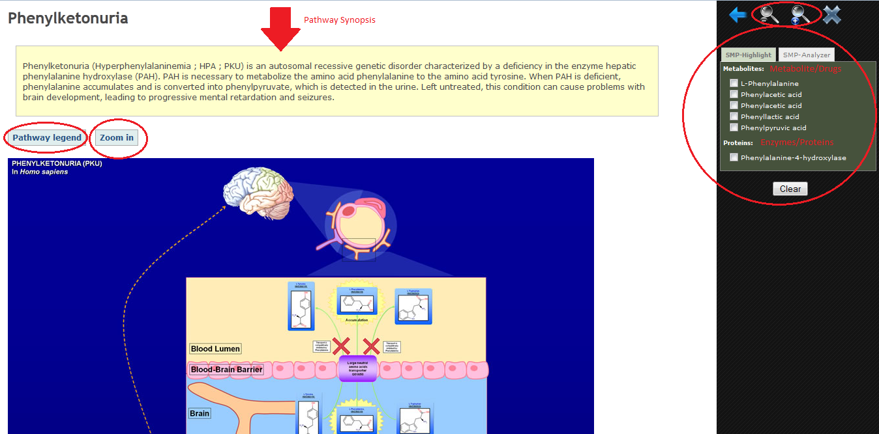

Slide 20
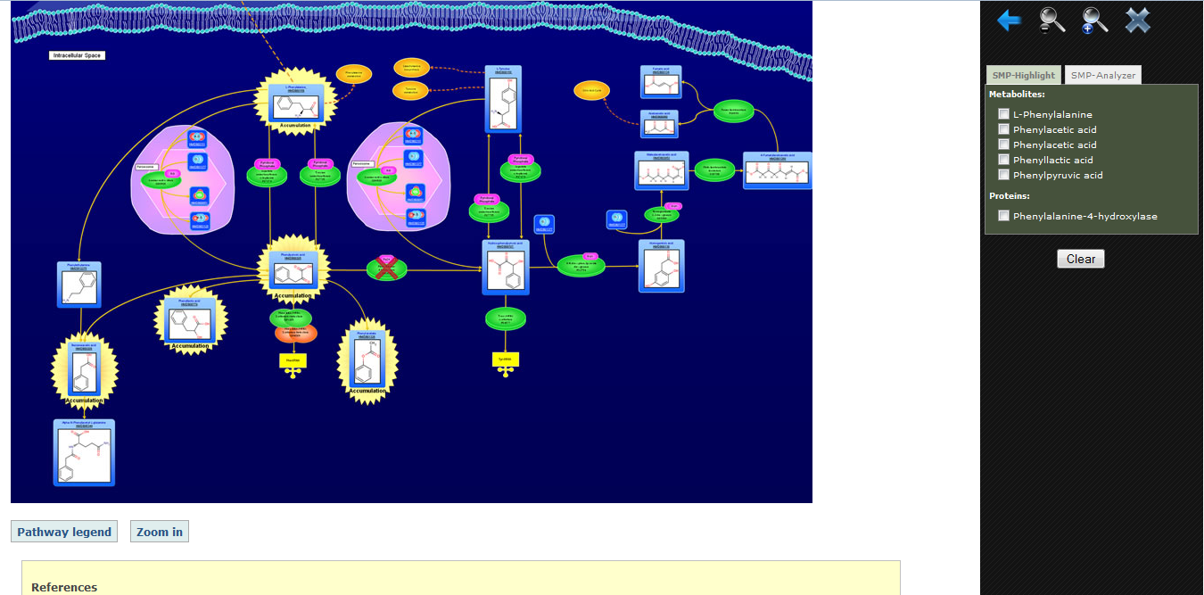

Slide 21
3.3.3 SMPDB –SMP-MAP Search Option
Powerful, multi-identifier search option.
Search by names(metabolite, drug, enzyme) or IDs(UniProt, DrugBank, GenBank, HMDB, Kegg)
Generates a table of pathways containing the search components, ordered by the number of matches.
The generated table has the same structure with SMP-Browse.

Slide 22
3.3.4 SMPDB –ChemQuery, TextQuery, SeqSearch Search Options
ChemQuery
Draw or write chemical compound
Find drugs and metabolites similar or identical to query compound
TextQuery is an advanced text search engine
SeqSearch is a BLAST sequence of the protein sequences contained in SMPDB.

Slide 23
3.3 SMPDB –Synopsis
The information provided by the pathway diagrams can produce users with information about:
The connection between metabolites,genes, proteins and metabolic diseases
The connection between drugs and their protein/gene targets.
Can provide information for a variety of translational bioinformatic questions.
Given a list of metabolites, find a disease or medical condition
Give a drug, dietary or treatment, find which diseases , conditions or pathways are affected.
Use metabolomic or metabolite expression data to help understand or rationalize specific metabolic diseases, conditions or biomarkers.
Determine the possible mechanism of action or protein targets for a newly ound/synthesized compound.
Verify whether a protein found in a microorganism could be a drug target(SeqSearch).
Ascertain if a newly identified human protein could be a drug target or disease indicator
Use the pathway visualization and mapping tools to explain or teach others about metabolic diseases, basic metabolism or drug action
The pathway visualization can be an education tool about metabolism, diseases and drug action.

Slide 24
4. HMDB – A Resource for Biomarker Discovery and Disease Diagnosis
Combines chemical data, spectral data, protein target data, biomarker data and disease data into a single resource
Contains comprehensive data on all of the known and measurable human endogenous metabolites.
Product of the 3-year and $7.5 million Human Metabolome Project.
Includes information about human metabolites:
Associated enzymes/transporters
Abundance
Disease related properties

Slide 25
4.1 HMDB – Database General Features
8000 metabolite entries connected to:
45000 synonyms
3360 enzymes linked to
100 metabolic pathways
150 disease pathways
1000 metabolites have disease associated information connected to 500 different diseases
Experimental metabolite concentration data for normal plasma, urine, CSF and other biofluids for 5000 compounds.
30 GB of data.

Slide 26
4.2 HMDB – Browsing Features
Built-in tools for viewing, sorting and extracting metabolites, biofluid concentrations, enzymes, genes, NMR or MS spectra and disease information
Supports standard text queries.
Multiple browse options:
HMDB Browse
Disease Browse
PathBrowse
Biofluid Browse
HML Browse
ClassBrowse

Slide 27
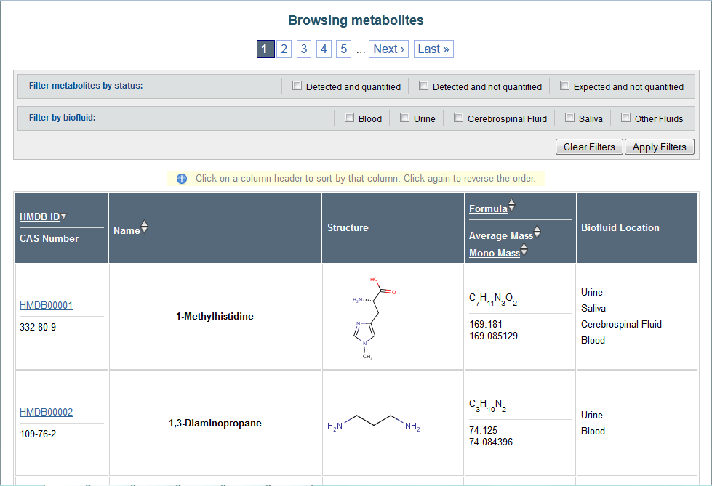

Slide 28
4.2.1 HMDB – HMDB MetaboCard Entries
Great detailed description of each compound of interest.
More than 100 data fields with half of them devoted to chemical or physico-chemical data and the other half devoted to biological or bio-medical data.
Comprehensive compound description.
Names and synonyms.
Structural and pathway information.
Physico-chemical data.
Gene and protein sequence data.
Disease associoations.
SNP and mutation data.
Extensive links to images, references and other public databases.

Slide 29
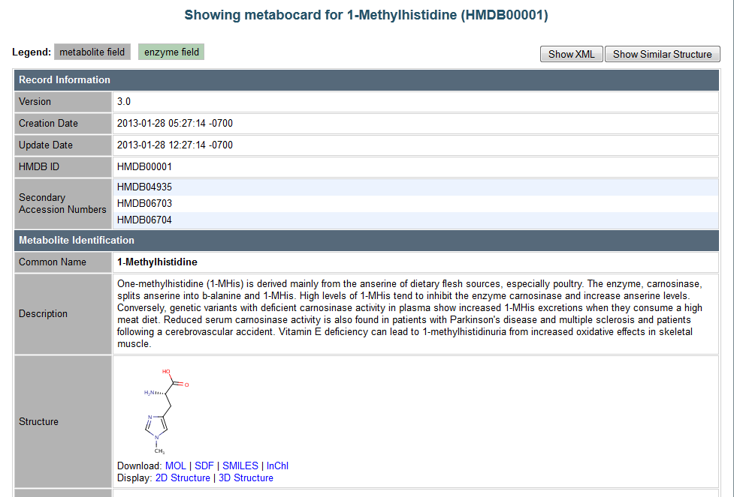

Slide 30
4.2.2 HMDB – HMDB Browse and Disease Browse Options
HMDB Browse
The default database browser.
Compound by compound search through hyperlinked, synoptic summary tables:
HMDB ID and CAS Number
Name
Chemical structure
Chemical form
Average and Mono Mass
Biofluid Location
Disease Browse
Views known metabolomic disorders and associated metabolites
Identifies which diseases are characterized by a list of metabolites

Slide 31
4.2.3 HMDB – PathBrowse and Biofluid Browse Options
PathBrowse
Browse through custom-drawn HMDB pathway images.
Each pathway has a name and each image is zoomable and extensively hyperlinked.
Search using list of compounds and view hyperlinked tables as in the HMBD Browse.
Biofluid Browse
Metabolite entries based on their concentrations and the biofluids in which they are found.
Includes sortable information, such as HMDB ID, concentration, associated disease(if any), age and gender.

Slide 32
4.2.4 HMDB – HML Browse and ClassBrowse Options
HML Browse
Search through the Human Metabolome Library, which contains 1000 reference metabolites stored in -80 Celcius degrees.
ClassBrowse
Views compounds according to their chemical class designation.
Each displayed compound is hyperlinked to an HMDB MetaboCard.
Compounds can be found via a text box or a selected compound class.

Slide 33
4.3.1 HMDB – Search Utilities
Text Query
An advanced search module for simple text search.
Chem Query
Structure similarity search tool.
Draw or paste a SMILES string of a query compound.
Finds and views common substructures that match the HMDB metabolite database with hyperlinks to the corresponding MetaboCards.
Supports compound searches on the basis of chemical formula and molecular weight ranges.
SeqSearch
HMDB’s BLAST search.
A gene or protein sequence is searched against metabolically important enzymes and tranporters.
Metabolites that may act on the query protein are displayed.

Slide 34
4.3.2 HMDB – Search Utilities
Data Extractor
Relational query search tool.
Allows users to select or search over various combinations of metabolite and enzyme fields through clickable web forms.
MS search
Users may submit mass spectral files, chemical formula or mass, that will be searched against the HMDB's library of MS/MS spectra
Identification of metabolites from mixtures via MS/MS spectroscopy.
HMDB’s mass spectra library contains 2400 spectra collected at 3 different collision energies.
1D and 2D NMR Search
Users submit peak lists from 1H or 13C NMR spectra compared to the NMR libraries contained in the HMDB.
Identification of metabolites from mixtures via NMR spectroscopy.
HMDB contains more than 2000 experimentally collected 1H and13C NMR spectra for 900 pure compounds.

Slide 35
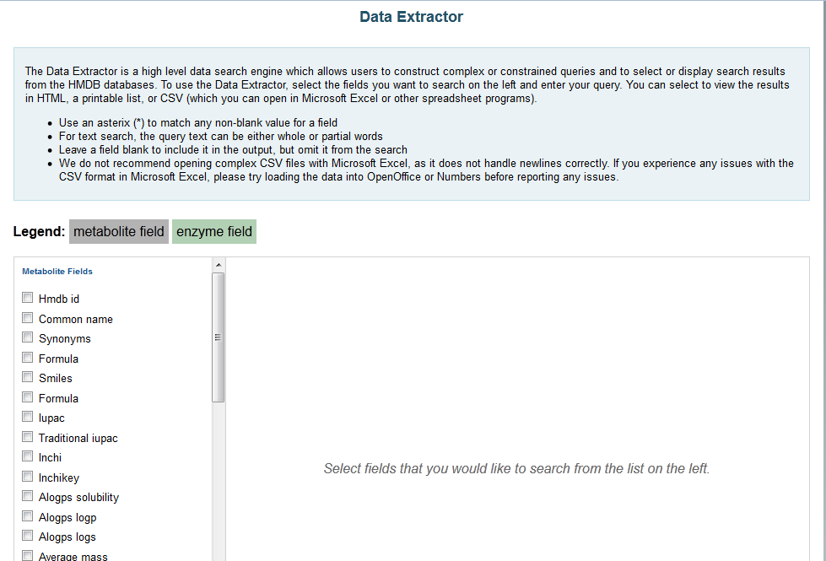

Slide 36
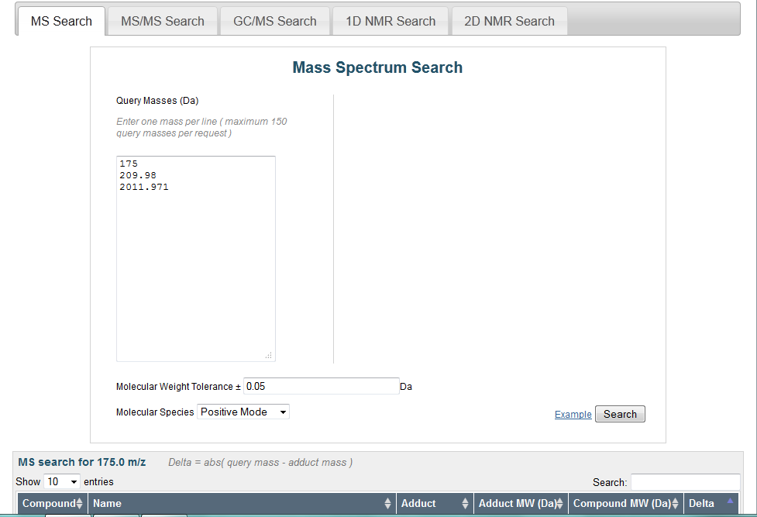

Slide 37
4.4 HMDB –Synopsis
HMDB database provides information about:
Linkage between endogenous metabolites to a variety of disease conditions such as metabolic disorders, genetic diseases,chronic (age-related) disorders and a variety of infectious diseases.
Linkage between metabolites and their targets.
Direct identification of potential diagnostic biomarkers based on their mass, mass spectra or NMR spectra.
Can also provide information for a variety of translational bioinformatic questions.
Identify a novel biomarker for a given condition or disease given an NMR or GC/MS or MS/MS spectrum of the purified compound.
Identify metabolites from a biofluid mixture that has been analyzed by NMR, GC/MS or MS/MS.
Identify a disease or condition given a list of metabolites.
Identify a pathway or process that has been altered/perturbed given a list of metabolites obtained from a metabolomic experiment.
Determine normal and abnormal concentration ranges for metabolites in different biofluids.
Obtain authentic standards of unique metabolites to confirm the diagnosis of a certain disease.
Determine the similarity of a newly found/synthesized compound to an existing metabolite .
Determine the possible mechanism of action or protein targets for a newly discovered/synthesized metabolite or metabolite analogue .
Diagnose or determine the cause of illnesses thought to be brought on by metabolite changes.
Extract detailed information on metabolites, metabolic diseases or metabolic pathway.
Extract information on common metabolite classes.
Ascertain whether a certain protein or protein homologue may also be involved in a metabolic process or pathway.

Slide 38
5. DrugBank – A Resource for Drug Discovery and Disease Treatment
Section overview
DrugBank belongs in the third major class of chemical bioinformatic databases are the drug or pharmaceutical product databases
It is a “hybrid” database, derived from both clinically and chemically oriented drug databases, as it combines the clinical/disease information of the clinically oriented drug databases with the biochemical/chemical information of the chemically oriented drug databases.
As a result, a typical DrugBank entry contains 80–100 different data fields, instead of 5–10 as seen with the other kinds of databases.
Like TTD and SuperTarget, DrugBank supports very extensive text, sequence and chemical structure searches.
It also provides detailed pathway information on the mechanism of action for >200 different drugs or drug classes.

Slide 39
5. DrugBank – Continue
presents drug and drug target data in synoptic DrugCards (in anology to library cards or study flash-cards)
easy to view and navigate
contains detailed information on 1480 FDA-approved drugs corresponding to 28,447 brand names and synonyms
1281 synthetic small molecule drugs,
128 biotech (mostly peptide or protein) drugs and
71 nutraceutical drugs or supplements
contains information on the 1669 different targets (protein, lipid or DNA molecules) and metabolizing enzymes with which these drugs interact
maintains data on 187 illicit drugs (i.e. those legally banned or selectively banned in most developed nations) and 64 withdrawn drugs (those removed from the market due to safety concerns)
Chemical, pharmaceutical and biological information about these classes of drugs is extremely important, not only in understanding their adverse reactions, but also in being able to predict whether a new drug entity may have unexpected chemical or functional similarities to a dangerous or highly addictive drug

Slide 40
5. DrugBank – Continue
Likewise HMDB, contains many built-in tools and a variety of customized features for viewing, sorting, querying and extracting drug or drug target data
higher-level database searching functions
Sequence search (such as SeqSearch of BLAST [1])
Single sequence/group of sequences/entire proteome can be searched by pasting the FASTA formatted sequence(s) into the SeqSearch query box
Boolean text search (TextSearch) for sophisticated text searching and querying
chemical structure search utility (ChemQuery) for structure matching and structure-based querying
sketch of a chemical structure or paste of a SMILES string [19] of a possible drug lead or a drug that appears to be causing an adverse reaction, into the ChemQuery window. High scoring hits are presented in a tabular format with hyperlinks to the corresponding DrugCards
relational data extraction tool (Data Extractor) for performing complex queries

Slide 41
5. DrugBank – Continue
Synopsis
DrugBank allows users to link drugs to a variety of disease conditions or health indications
provides links between drugs and their targets – both through descriptions of the mechanism of action and through the identification of known protein (or gene) targets
support a number of translational bionformatic or cheminformatic questions. e.g.:
determine the similarity of a newly found/synthesized compound to an existing drug (via the structure similarity search);
determine the possible mechanism of action or protein targets for a newly found/synthesized compound (via the structure similarity search);
diagnose or determine the cause of illnesses thought to be brought on by adverse drug reactions (through the text search or SNPADR/SNPFX);
treat or find references to the treatment of illnesses based on symptoms or disease diagnosis (via the text search);
extract information on common drug targets (via the data extractor or the sequence search);
extract information on common drug classes or structures (via the data extractor or the structure search);
ascertain whether a certain protein found in bacteria, fungi or viruses could be a drug target (via the sequence search);
ascertain whether a newly identified human protein, such as an isoform or paralogue, may be a drug target (through the sequence search)

Slide 42
6. T3DB – A Resource linking Small Molecules to Disease & Toxicity
Section overview
T3DB[18] belongs in the fourth and final major class of chemical-bioinformatic databases which are the toxic substance databases
T3DB (which stands for the Toxin, Toxin-Target Database) provides very extensive structural, physiological, mechanistic, medical and biochemical information on about 3100 commonly encountered (i.e. household or environmental) toxins and poisons.
It refers to toxicogenomics or toxicology specialists
Is relatively well annotated, with more than a dozen data fields per compound and essentially
associates toxins and their biological targets with symptoms, conditions, diseases and disease treatments

Slide 43
6. T3DB – Continue
Definitions
toxic substance
is a small molecule, peptide, or protein that is capable of causing injury, disease, genetic mutations, birth defects or death
Toxins
natural and man-made
represent an important class of poisonous compounds that are ubiquitous in nature, in homes, and in the workplace
include pollutants, pesticides, preservatives, drugs, venoms, food toxins, cosmetic toxins, dyes, and cleaning compounds

Slide 44
6. T3DB – Continue
T3DB [18] is currently the only chemical-bioinformatic database that provides in-depth, molecular-scale information about toxins, their associated targets, their toxicology, their toxic effects and their potential treatments
contains over 3000 toxic substance entries corresponding to more than 34,000 different synonyms
connected to some 1450 protein targets through almost 35,500 toxin and toxin-target associations
supported by more than 5400 references
Fully searchable web resource with many built-in tools and features for viewing, sorting and extracting toxin and toxin-target annotation, including structures and gene and protein sequences (like HMDB and DrugBank)
supports standard text queries
offers general database browsing
divided into synoptic summary tables which are linked to more detailed “ToxCards” (analogous to the DrugCard - DrugBank [20] or the MetaboCard - HMDB [21])
Each ToxCard entry contains over 80 data fields, with ~50 data fields devoted to chemical and toxicological/medical data and ~30 data fields (each) devoted to describing the toxin target(s)
provide 30 data fields that include both chemical and biological (sequence, molecular weight, gene ontology terms, detailed toxicity and toxicological data, including route of delivery, mechanism of action, medical information, toxicity measurements, hyperlinks to other databases, abstracts, digital images and interactive applets for viewing the molecular structures of each toxic substance, etc.)

Slide 45
6. T3DB – Continue
Synopsis
T3DB allows users to link toxic substances to a variety of disease conditions, including acute toxicity, long-term toxicity, birth defects, cancer, other illnesses
provides links between toxic substances and their targets – both through descriptions of the mechanism of action and through the identification of known protein (or gene) targets
support a number of translational bionformatic or cheminformatic questions. e.g.:
determine the similarity of a newly found/synthesized compound to an existing toxin (via the structure similarity search);
determine the possible mechanism of action or protein targets for a newly found/synthesized compound (via the structure similarity search);
diagnose or determine the cause of illnesses thought to be brought on by exposure to a given toxin (through the text search);
treat or find references to the treatment of illnesses brought on by exposure to a given toxin (via the text search);
extract information on common toxin targets (via the data extractor);
extract information on common toxin classes (via the data extractor);
ascertain whether a certain protein or protein homologue may also be a toxin target (via the sequence search);
ascertain whether a newly identified peptide or protein may be a toxin (through the sequence search)

Slide 46
7. Software for Interpreting Small Molecule and Disease Data
Recent emergence of chemical-bioinformatic databases caused the development of software tools that exploit these databases.
As the field of chemical bioinformatics is still quite young the number of software tools developed to exploit these databases is still quite small.
PolySearch and MSEA are two recently developed software tools that exploit the data in SMPDB, HMDB and DrugBank to perform a number of useful applications.

Slide 47
7.1 Text Mining with PolySearch
Free, web-based text-mining tool.
Allows users to search through large numbers of PubMed abstracts to make large-scale linkages or associations.
Rapidly performed automated repeated queries.
Query type is “Given X, find all Y’s”, where X or Y are diseases, tissues, cell compartments, gene/protein names, SNPs, mutations, drugs and metabolites.
X’s and Y’s names and synonyms are derived form UniProt, DrugBank, HMDB, MeSH.
The greater the frequency with which an X and Y association occurs within a collection of abstracts, the more significant the association is likely to be.

Slide 48
7.2 Metabolite Set Enrichment Analysis
A web-based tool designed to help researchers identify and interpret patterns of human or mammalian metabolite concentration changes in a biologically meaningful context.
MSEA pathway and disease data set is somewhat larger than what is found in the HMDB or SMPDB.
Analytical software tool that exploits chemical-bioinformatic data to perform robust statistical analyses of metabolomic or clinical chemistry data.
The resulting metabolite sets were organized into three categories: pathway-associated, disease-associated, and location based.
MSEA’s pathway-associated metabolite library contains 84 entries based on the 84 human metabolic pathways found in SMPDB.

Slide 49
8. Summary
Emergence of a new field of bioinformatics – called chemical bioinformatics.
Role that chemical bioinformatics can play in identifying the chemicals that cause, cure or characterize many human diseases.
Most important or widely used chemical bioinformatic resources overview.
Detailed discussion of some of the major classes of chemical-bioinformatic databases.
Small molecule (or metabolic) pathway databases
Metabolite or metabolomic databases.
Drug databases.
Toxin or toxic substance databases.
Description of recently developed databases that explicitly relate small molecules to disease
Small Molecule Pathway Database (SMPDB).
Human Metabolome Database (HMDB).
DrugBank.
Toxin, Toxin-Target Database (T3DB).
Newly emerging software tools that exploit these databases, including PolySearch and MSEA.
Chemical bioinformatics will soon be able to establish itself as one of the most medically useful sub-disciplines in the entire field of bioinformatics.

Slide 50
Misc - Links
Some useful links
http://www.ploscompbiol.org/article/info%3Adoi%2F10.1371%2Fjournal.pcbi.1002805#s7: the article of the presentation
http://www.ploscollections.org/: The Public Library of Science Collection
http://www.plos.org/ : The Public Library of Science Main Page
http://www.ploscompbiol.org/article/fetchSingleRepresentation.action?uri=info:doi/10.1371/journal.pcbi.1002805.s001 : useful questions and exercises with solutions for our presentation’s databases
http://www.smpdb.ca/ : Small Molecule Pathway Database
http://www.hmdb.ca/: Human Metabole Database
http://www.drugbank.ca/: Open Data Drug & Drug Target Database
http://www.t3db.org/: Toxin, Toxin-Target Database

Slide 51
Misc – Links - Continue
some examples
Your natural product chemist neighbor has just isolated a compound from the Tanzanian periwinkle – a rare plant species found only in the highlands of Eastern Tanzania. Locals use the plant as a treatment for a variety of blood disorders. The structure of the compound is given by the following SMILES string: COC1=CC=C2C(=CC1=O)C(CCC1=CC(OC)=C(OC)C(OC)=C21)NC(CO)
What compound is this similar to, what diseases could it be used to treat and what proteins might it bind?
DrunkBank - ChemQuery
A farmer who has just finished harvesting his barley field has come into the clinic complaining of skin irritation, burning and itching, a rash and a series of skin blisters. He also has eye pain, conjunctivitis, burning sensations about the eyes, and blurred vision. Other symptoms have included nausea, vomiting and fatigue. Suspecting that he may have been exposed to some toxin or pesticide a chemical analysis has been performed of his blood, urine and lacrimal (tear) fluid. MS analysis of all three fluids has identified an unusual compound with a molecular weight of 296.126 daltons. What compound might this be?
T3DB - Data Extractor Tool

Slide 52
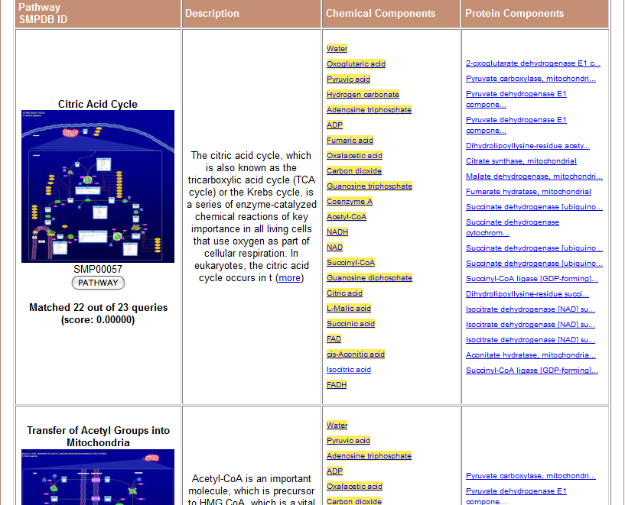
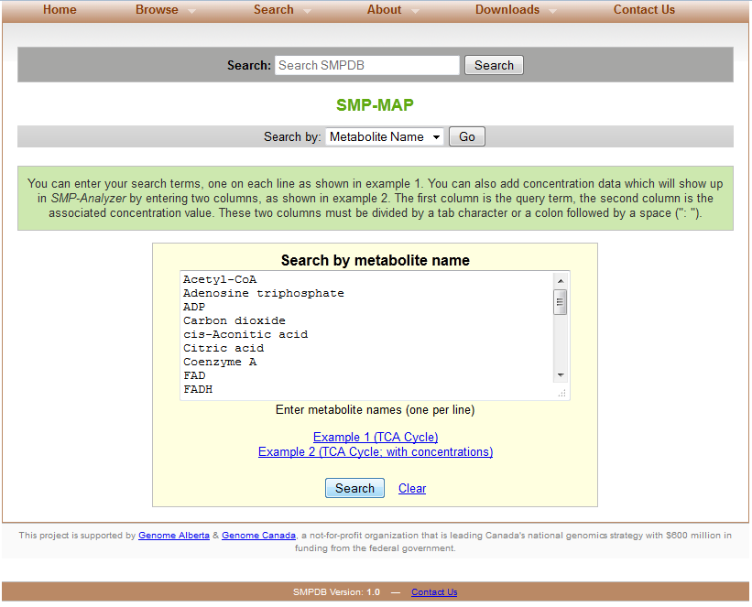
Misc – Links - Continue
and some example figures from DBs usage
SMPDB

Slide 53
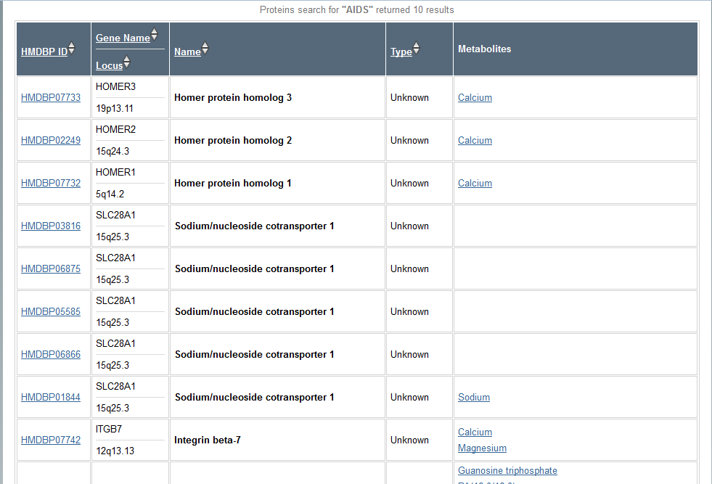
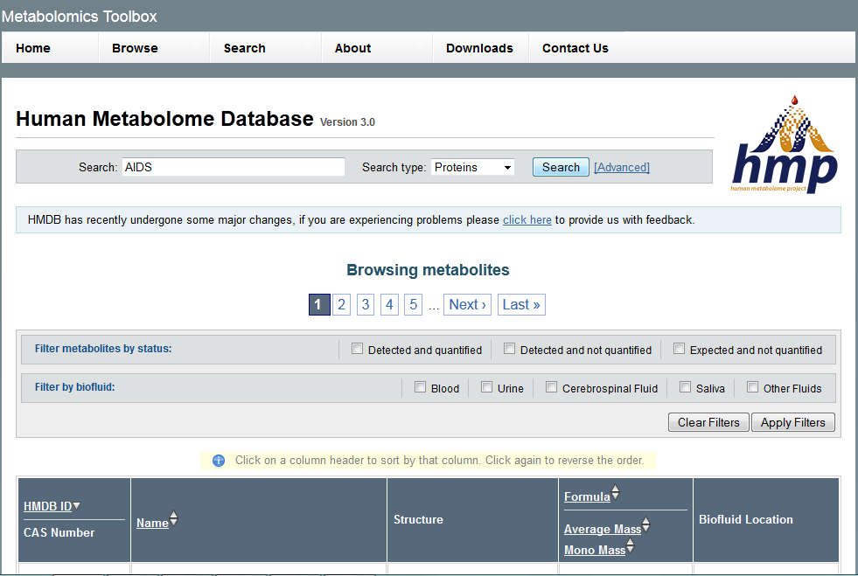
Misc – Links - Continue
HMDB

Slide 54
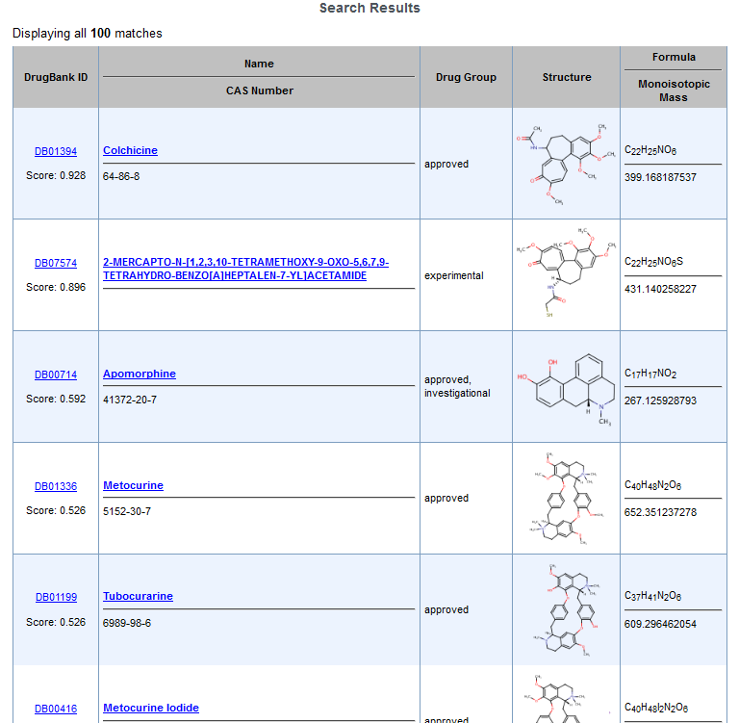
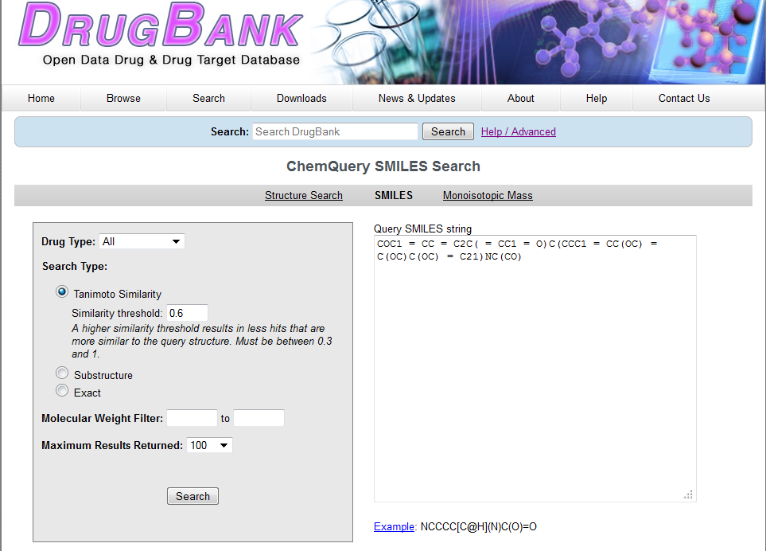
Misc – Links - Continue
DrugBank

Slide 55
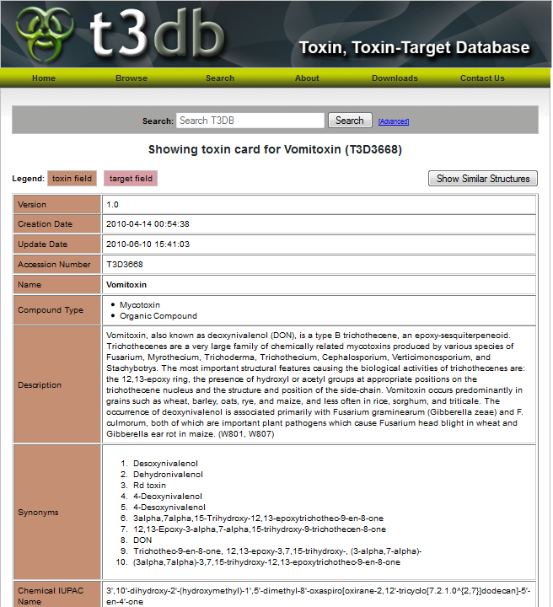
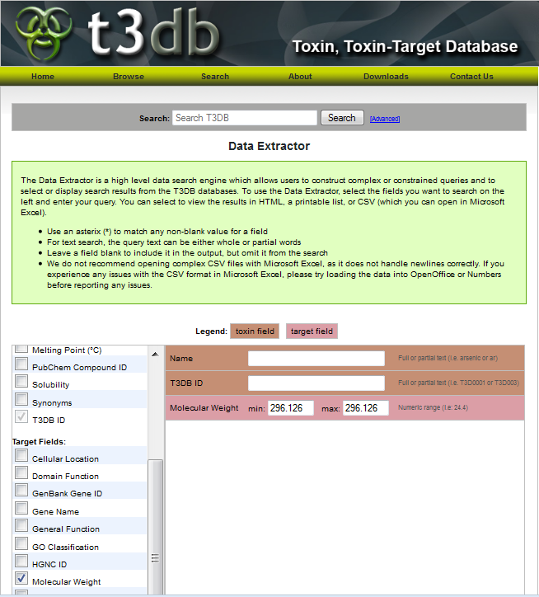
Misc – Links - Continue
T3DB

Slide 56
Bibliography
Altschul SF, Madden TL, Schäffer AA, Zhang J, Zhang Z, et al. (1997) Gapped BLAST and PSI-BLAST: a new generation of protein database search programs. Nucleic Acids Res 25: 3389–3402. doi: 10.1093/nar/25.17.3389. Find this article online
Benson DA, Karsch-Mizrachi I, Lipman DJ, Ostell J, Sayers EW (2010) GenBank. Nucleic Acids Res 38: D46–51. Find this article online
McGuffin LJ, Bryson K, Jones DT (2000) The PSIPRED protein structure prediction server. Bioinformatics 16: 404–405. doi: 10.1093/bioinformatics/16.4.404. Find this article online
Westbrook J, Feng Z, Jain S, Bhat TN, Thanki N, et al. (2002) The Protein Data Bank: unifying the archive. Nucleic Acids Res 30: 245–248. doi: 10.1093/nar/30.1.245. Find this article online
Frolkis A, Knox C, Lim E, Jewison T, Law V, et al. (2010) SMPDB: The Small Molecule Pathway Database. Nucleic Acids Res 38: D480–487. doi: 10.1093/nar/gkp1002. Find this article online
Kanehisa M, Goto S, Hattori M, Aoki-Kinoshita KF, Itoh M, et al. (2006) From genomics to chemical genomics: new developments in KEGG. Nucleic Acids Res 34: D354–357. doi: 10.1093/nar/gkj102. Find this article online
Karp PD, Riley M, Paley SM, Pelligrini-Toole A (1996) EcoCyc: an encyclopedia of Escherichia coli genes and metabolism. Nucleic Acids Res 24: 32–39. doi: 10.1093/nar/25.1.43. Find this article online

Slide 57
Bibliography - Continue
Krummenacker M, Paley S, Mueller L, Yan T, Karp PD (2005) Querying and computing with BioCyc databases. Bioinformatics 21: 3454–3455. doi: 10.1093/bioinformatics/bti546. Find this article online
Joshi-Tope G, Gillespie M, Vastrik I, D'Eustachio P, Schmidt E, et al. (2005) Reactome: a knowledgebase of biological pathways. Nucleic Acids Res 33: D428–432. doi: 10.1093/nar/gki072. Find this article online
Polen HH, Zapantis A, Clauson KA, Jebrock J, Paris M (2008) Ability of online drug databases to assist in clinical decision-making with infectious disease therapies. BMC Infect Dis 8: 153. doi: 10.1186/1471-2334-8-153. Find this article online
Hatfield CL, May SK, Markoff JS (1999) Quality of consumer drug information provided by four Web sites. Am J Health Syst Pharm 56: 2308–2311. Find this article online
Zhu F, Han B, Kumar P, Liu X, Ma X, et al. (2010) Update of TTD: Therapeutic Target Database. Nucleic Acids Res 38: D787–791. doi: 10.1093/nar/gkp1014. Find this article online
Hamosh A, Scott AF, Amberger J, Valle D, McKusick VA (2000) Online Mendelian Inheritance in Man (OMIM). Hum Mutat 15: 57–61. doi: 10.1002/(SICI)1098-1004(200001)15:1<57::AID-HUMU12>3.0.CO;2-G. Find this article online
Günther S, Kuhn M, Dunkel M, Campillos M, Senger C, et al. (2008) SuperTarget and Matador: resources for exploring drug-target relationships. Nucleic Acids Res 36: D919–922. doi: 10.1093/nar/gkm862. Find this article online

Slide 58
Bibliography - Continue
Schmidt U, Struck S, Gruening B, Hossbach J, Jaeger IS, et al. (2009) SuperToxic: a comprehensive database of toxic compounds. Nucleic Acids Res 37: D295–299. doi: 10.1093/nar/gkn850. Find this article online
Judson R, Richard A, Dix D, Houck K, Elloumi F, et al. (2008) ACToR–Aggregated Computational Toxicology Resource. Toxicol Appl Pharmacol 233: 7–13. doi: 10.1016/j.taap.2007.12.037. Find this article online
Davis AP, Murphy CG, Saraceni-Richards CA, Rosenstein MC, Wiegers TC, et al. (2009) Comparative Toxicogenomics Database: a knowledgebase and discovery tool for chemical-gene-disease networks. Nucleic Acids Res 37: D786–792. doi: 10.1093/nar/gkn580. Find this article online
Lim E, Pon A, Djoumbou Y, Knox C, Shrivastava S, et al. (2010\) T3DB: a comprehensively annotated database of common toxins and their targets. Nucleic Acids Res 38: D781–786. doi: 10.1093/nar/gkp934. Find this article online
Weininger D (1988) SMILES 1. Introduction and encoding rules. J Chem Inf Comput Sci 28: 31–38. doi: 10.1021/ci00057a005. Find this article online
Wishart DS, Knox C, Guo AC, Shrivastava S, Hassanali M, et al. (2006) DrugBank: a comprehensive resource for in silico drug discovery and exploration. Nucleic Acids Res 34: D668–672. doi: 10.1093/nar/gkj067. Find this article online
Wishart DS, Knox C, Guo AC, Eisner R, Young N, et al. (2009) HMDB: a knowledgebase for the human metabolome. Nucleic Acids Res 37: D603–610. doi: 10.1093/nar/gkn810. Find this article online

Slide 59
Thank you!
This presentation stands as a supplementary to the original article “Small Molecules and Diseases” [David S. Wishart] part of the “Transitional Bioinformatics” collection for PLOS Computational Biology, and it is recommended to be read alongside the article.
Begetis Nikolaos
Konstantopoulos Dimitrios

